Slide 1
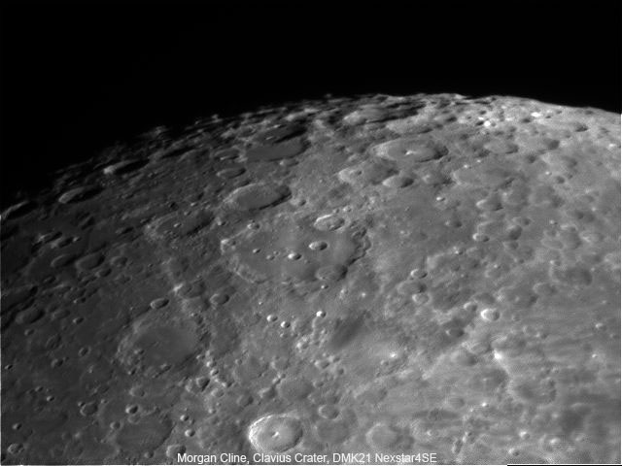

Slide 2
“What’s up”
A presentation of “what’s up” in the night sky

Slide 3
This Month’s Sky: September2012
Our Solar System Tonight
This Month’s Astro Events
Target List
Gee Whiz Question of the Month
CE Observing Challenge

Slide 4
Our Solar System Tonight
 | Rises | Sets
Sun | 7:44 A.M. | 6:55 P.M.
Moon | 1:11 P.M. | 11:48 P.M.
Mercury | 9:41 A.M | 7:54 P.M
Venus | 4:48 A.M. | 5:20 P.M.
Mars | 11:10 A.M. | 9:06 P.M.
Jupiter | 9:30 P.M. | 11:41 A.M.
Saturn | 8:03 A.M. | 7:13 P.M.
Uranus | 5:51 P.M. | 6:07 A.M.
Neptune | 4:17 P.M. | 3:20 A.M.
Pluto | 12:59 P.M. | 11:14 A.M.

Slide 5
This Month’s Astro Events
Orionid Meteor Shower
Oct. 21st-22nd- Look ESE (Up to 15/Hour)
Asteroid Pallas
Demon Star Algol
“Ghost of the Summer Sun”

Slide 6
Orionids Meteor Shower
Peak: Oct. 21-23; Max 15-20/Hour

Slide 7
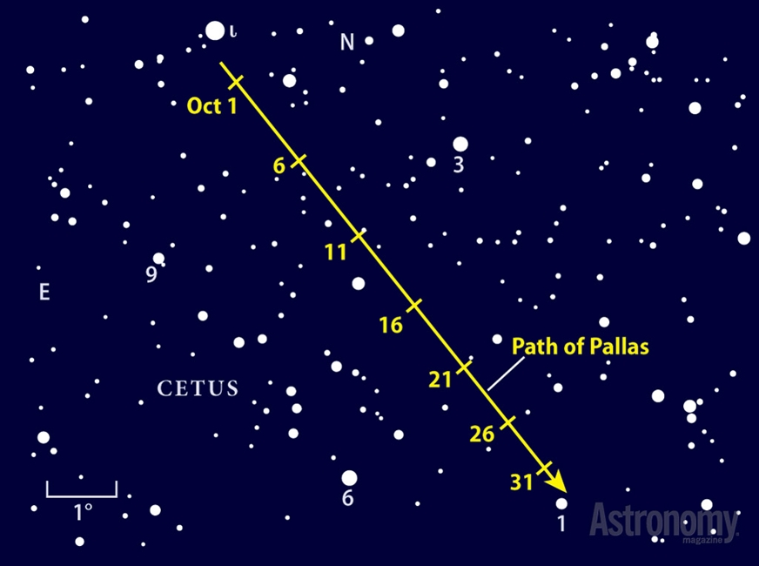
Asteroid Pallas
Path of Pallas

Slide 8
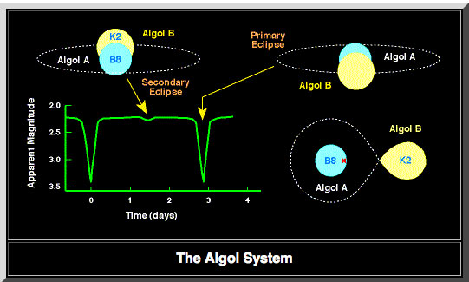
Demon Star: Algol
Named such as it is at the head of Medusa

Slide 9
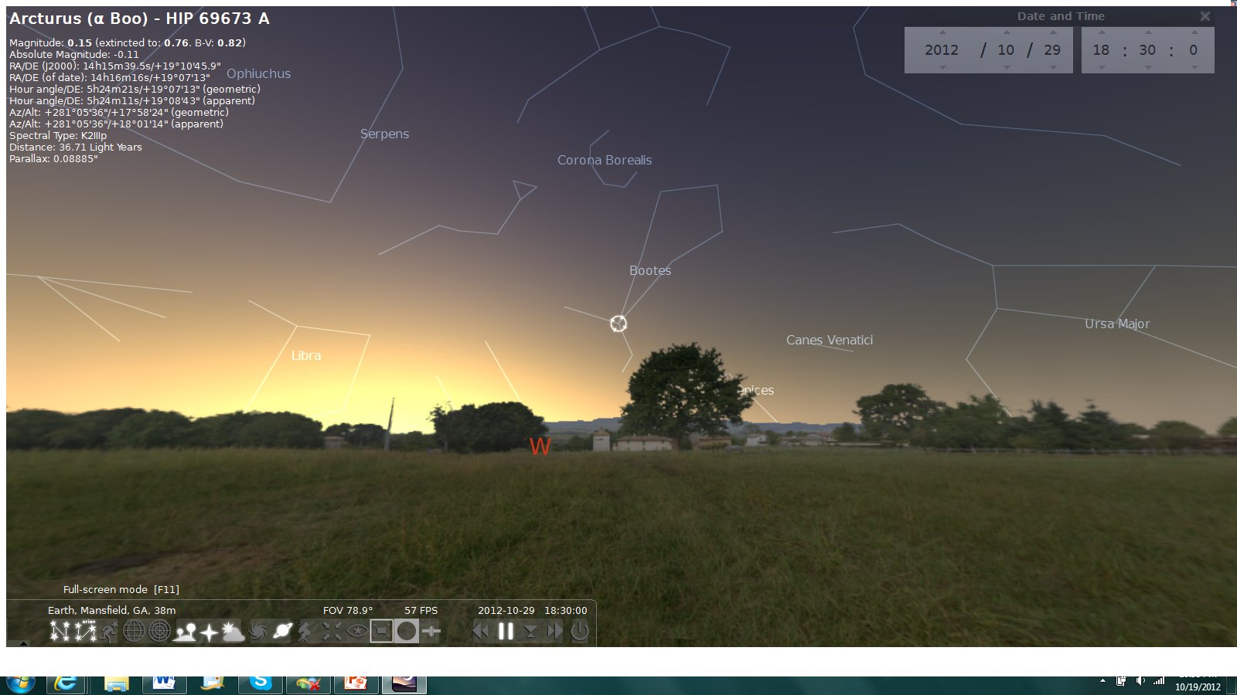
Ghost of the Summer Sun
On and around Oct. 29th, Arcturus will be in approximately
the same spot as the Sun was in June/July

Slide 10
Target List
Object | Type | Mag | Constellation
M20(Trifid) | Nebula | 6.3 | Sagittarius
M8 (Lagoon) | Nebula | 6 | Sagittarius
M29 | Open Cluster | 7 | Cygnus
NGC 6995 (E. Veil) | Nebula | 5 | Cygnus
M15 | Globular Cluster | 6.2 | Pegasus
Pallas | Asteroid | 8.7 | Cetus
Vesta | Asteroid | 7.4 | Taurus
Ceres | Asteroid | 8.2 | Gemini
M31 (Andromeda) | Spiral Galaxy | 3.40 | Andromeda

Slide 11
Gee Whiz Question of the Month
In Astronomy terms, what is a “Bolide”?

Slide 12
Gee Whiz Question of the Month
A very bright meteor (or fireball) that produces a sonic boom.

Slide 13
CE Observing Challenge
Asteroid “Juno”
Magnitude 11.4 (very difficult)
In Ophiuchus
R.A: 16h 37m 28.31s W
Dec: -11° 11’ 10.2”
ENJOY!!!

Slide 14
Useful Websites
http://www.almanac.com/astronomy/
http://astrojourney.wordpress.com
http://www.astronomy.com/

